Slide 1
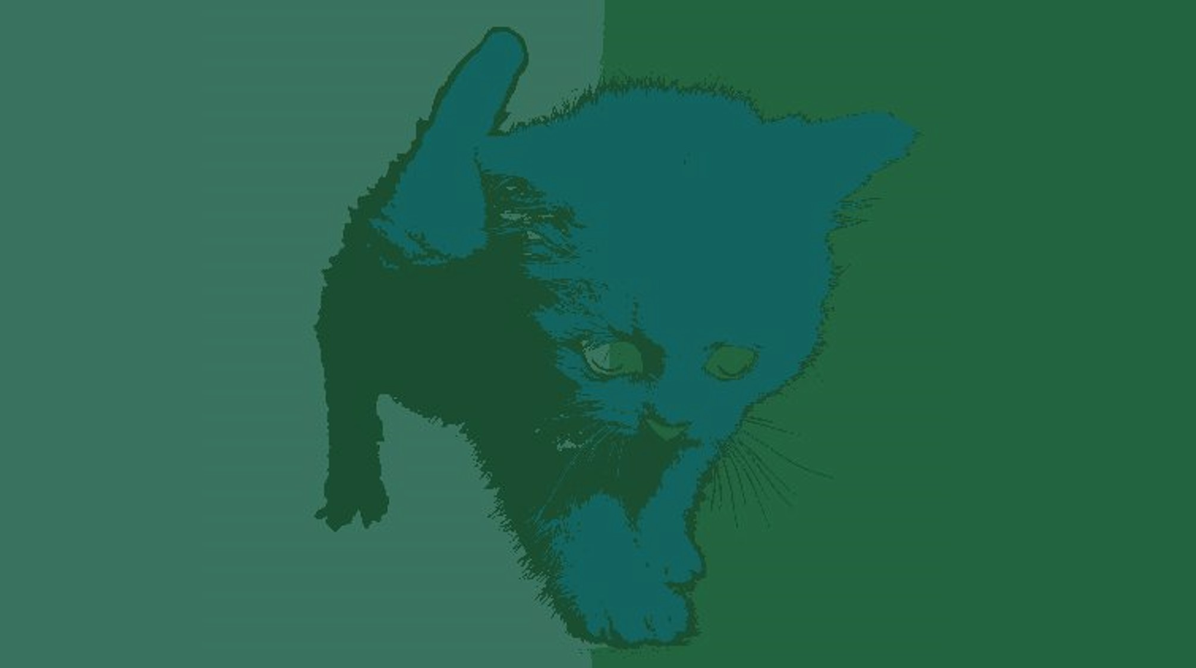
HOME
PART 1
PART 2
PART 3
Image Foreground/Background Segmentation
using Network Flow
Group Member:
Hongchen Guo
Weichao Zhou
Xiaoxi Chen
Xinyu Li
Yanjiang Dong

Slide 2
HOME
PART 1
PART 2
PART 3
Introduction
01 What is Image Segmentation
partition an image into multiple segments
02
Project Description
Notes:
Image Segmentation: image segmentation is the process of partitioning a digital image into multiple segments according to some certain features
Project Description: segment the foreground from the background in an image as fast as we could(这块可以再改改）

Slide 3


HOME
PART 1
PART 2
PART 3
1st K-Means Algorithm
2nd Ford-Fulkerson Algorithm
Algorithms & Implementations
3rd Push-Relabel Algorithm
4th Dinic’s Algorithm
Notes:
F-F: Starting from zero flow, increase the flow gradually by finding a path from s to t along which more flow can be sent, until a max-flow is achieved

Slide 4
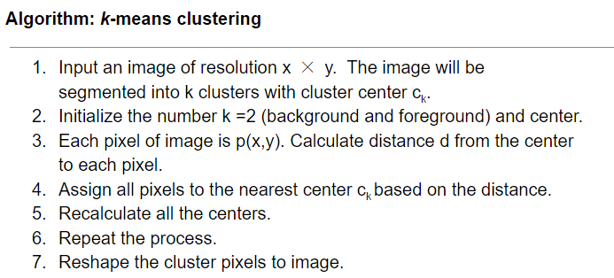
HOME
PART 1
PART 2
PART 3
1
K-Means
Algorithm
Notes:
k-means clustering algorithm partitions the data into k number groups and classifies them into k disjoint clusters. The algorithm requires to calculate k centroid. And it takes each point to the cluster which has nearest centroid from the respective point. The distance is determined by Euclidean distance. After the grouping process, it recalculates new centroid for each cluster, and a new distance is then calculated. The centroid for each cluster is the point that the sum of distances of all the clusters to this point is minimized. After a number of iterations, the sum of distances from each object to its centroid of all clusters is minimized. The detail of the algorithm is shown as below:

Slide 5
HOME
PART 1
PART 2
PART 3
1
1
Tools
K-Means
Algorithm
TkInter
Sklearn
2
Implementation
Extended to k-segment
Add in coordinate information
Developed an interactive application

Slide 6
HOME
PART 1
PART 2
PART 3
K-Means Demo

Slide 7
HOME
PART 1
PART 2
PART 3
2
1
Generate Residual Graph
Ford-Fulkerson
Algorithm
2
Augmenting Path
4
10
10
8
t
s
2
6
10
9
10
3
Saturate the Path
Notes:
Standard augmenting paths based algorithms, such as Dinic algorithm [12], work by pushing flow along non-saturated paths from the source to the sink until the maximum flow in the graph G is reached. If a path is found then the algorithm augments it by pushing the maximum possible flow df that saturates at least one of the edges in the path. Each augmentation increases the total flow from the source to the sink f = f + df. The maximum flow is reached when any s → t path crosses at least one saturated edge in the residual graph Gf .
Dinic algorithm uses breadth-first search to find the shortest paths from s to t on the residual
graph Gf . After all shortest paths of a fixed length k are saturated, the algorithm starts the
breadth-first search for s → t paths of length k + 1 from scratch. Note that the use of shortest
paths is an important factor that improves theoretical running time complexities for algorithms
based on augmenting paths. The worst case running time complexity for Dinic algorithm is O(mn2) where n is the number of nodes and m is the number of edges in the graph.
Push-relabel algorithms use quite a different approach. They do not maintain a valid flow during the operation; there are “active” nodes that have a positive “flow excess”. Instead, the algorithms maintain a labeling of nodes giving a low bound estimate on the distance or height to the sink along non-saturated edges. The algorithms attempt to “push” excess flows towards nodes with smaller estimated height. Typically, the “push” operation is applied to active nodes with the highest node or based on FIFO selection strategy. The distances (labels) progressively increase as edges are saturated by push operations. Undeliverable flows are eventually drained back to the source. We recommend our favorite text-book on basic graph theory and algorithms [11] for more details on push-relabel and augmenting path methods.

Slide 8
HOME
PART 1
PART 2
PART 3
1
Initialize residual graph G as given graph
4
Dinic’s Algorithm
4
10
8
t
s
2
6
10
9
10
2
ddd
3
Implementation

Slide 9
HOME
PART 1
PART 2
PART 3
Push d_{f} (u,v) = min(e[u], c_{f}(u,v)) units of flow from u to v:
d_{f}(u,v) ← min(e[u], c_{f}(u,v))
f [u,v] ← f [u,v] + d_{f}(u,v)
f [v,u] ← -f [u,v]
e[u] ← e[u] – d_{f}(u,v)
e[v] ← e[v] + d_{f}(u,v)
3
1
Initialize
Push-Relabel Algorithm
2
Push
Applied when: u is overflowing, c_{f} (u,v) > 0 , and h(u) = h(v) +1
3
Applied when:u is overflowing and for all v ∈V such that (u, v) ∈ E_{f}, we have h(u) ≤ h(v)
4
Implementation
Notes:
There are two basic operations used in the algorithm. Throughout its execution, the algorithm maintains a "preflow" and gradually converts it into a maximum flow by moving flow locally between neighboring nodes using push operations under the guidance of an admissible network maintained by relabel operations
2. The algorithm starts by creating a residual graph, initializing the preflow values to zero and performing a set of saturating push operations on residual arcs exiting the source. Similarly, the labels are initialized such that the label at the source is the number of nodes in the graph, 𝓁(s) = | V |, and all other nodes are given a label of zero. Once the initialization is complete the algorithm repeatedly performs either the push or relabel operations against active nodes until no applicable operation can be performed.

Slide 10
HOME
PART 1
PART 2
PART 3
3
4
Implementation
Push-Relabel Algorithm

Slide 11
HOME
PART 1
PART 2
PART 3
Maxflow Demo

Slide 12
HOME
PART 1
PART 2
PART 3
Thanks!

